Slide 1

ARK Fund Applet
Brandon Tran Jan2021

Slide 2
Disclaimer
I am not a financial adviser
This applet project is purely for my own education in both programming & finance
If you wish to use this project for your own purposes, please use responsibly
I am not a lawyer
I assume that because the information is publicly available to download, it is therefore reasonable to play with the data
However most of the time … assuming is never right! Therefore, I am not a lawyer

Slide 3
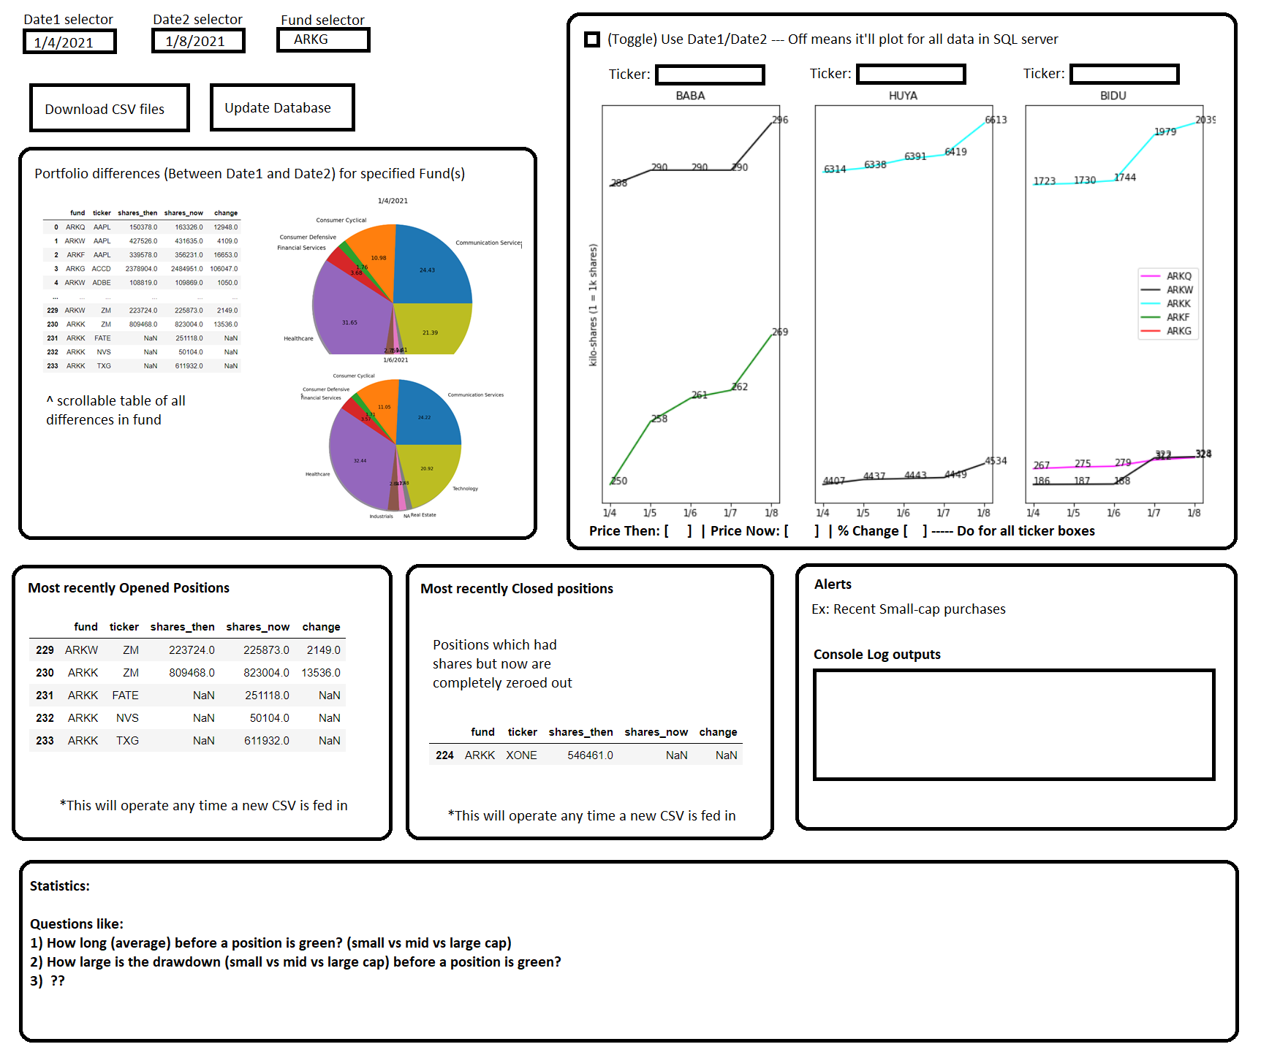
Applet Design (Brainstorm)

Slide 4
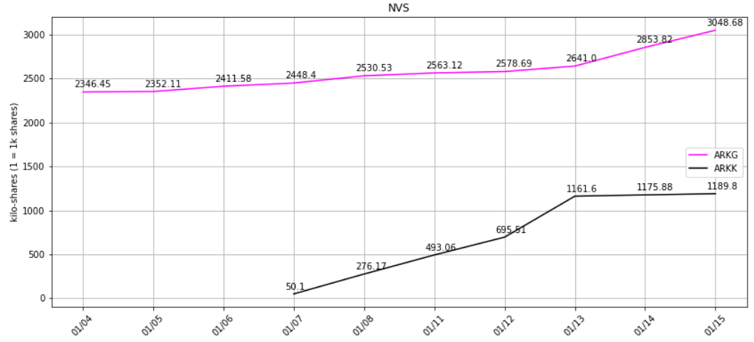
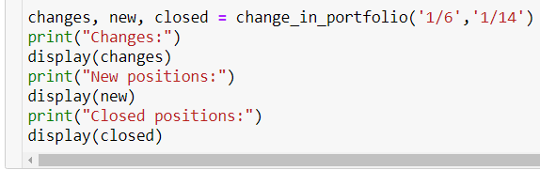
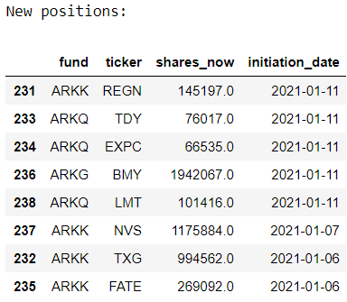
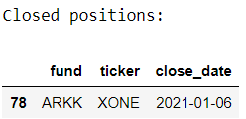
Change Logs – 1/17
Change_in_portfolio() issues:
1) date1/date2 required
2) new df wouldn’t properly populate unless the new position occurred on the exact transition from X to Y date
3) same issue as #2 with `closed` df
Solution:
1) Now defaults to previous day + current session if not provided
2) Created `unique_dates` & `loc_initial_date` variables so that “1/11” would expand the search to “1/10”… because you can’t know a position is new unless you know it wasn’t there yesterday.
3) Along with #2’s soln, changed `a` and `b` to generate from `unique_dates[loc_initial_date]` instead of `date1` to capture that initial date
4) Did some small house cleaning by dropping unnecessary columns (like cap,market_cap) in preprocessing
ticker_lookup() Issues:
1) “FATE” (ARKK had started purchasing it on 1/7) would screw up the x-axis
2) Legend was incorrectly stating which fund was which line (Ex: ARKG doesn’t buy Paypal)
Solution:
1) Created `date_val` and `date_label` variables to appropriately handle a changing x-axis
2) Created `fund_labels` to appropriately point the data to the fund
This command now correctly notes any new/closed positions between the dates provided

Slide 5
Change Logs – 1/17
change_in_portfolio update
Functionality for an “alert” system prompted the computation of “Percent Change” column
Alert system update
Need to find a way to trigger an alert message whenever X occurs
Currently taking X as a 10% increase or decrease in position sizing

Slide 6
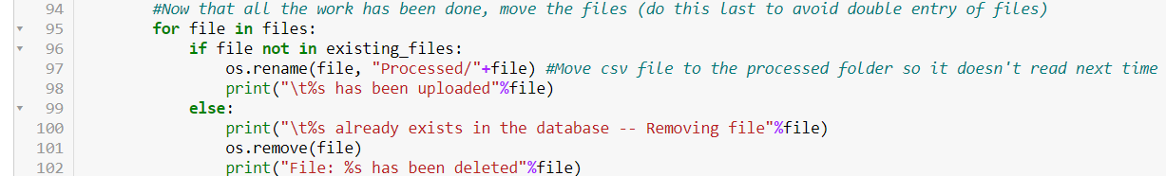
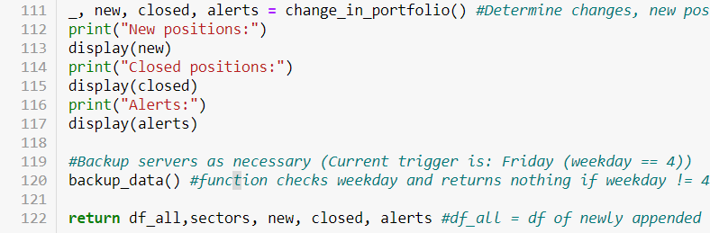
Change Logs – 1/18
update_arkfund()
Issue:
Holidays such as MLK weekend will still trigger the download script, but the data already exists from a previous date.
Soln:
Remove file if it exists (previously only mentioned the file was duplicate but took no action)
update_arkfund()
Alerts:
Best time to run alerts is when the main script is ran
Moved “change_in_portfolio” earlier in the jypnb and called the function at end of update_arkfund()

Slide 7
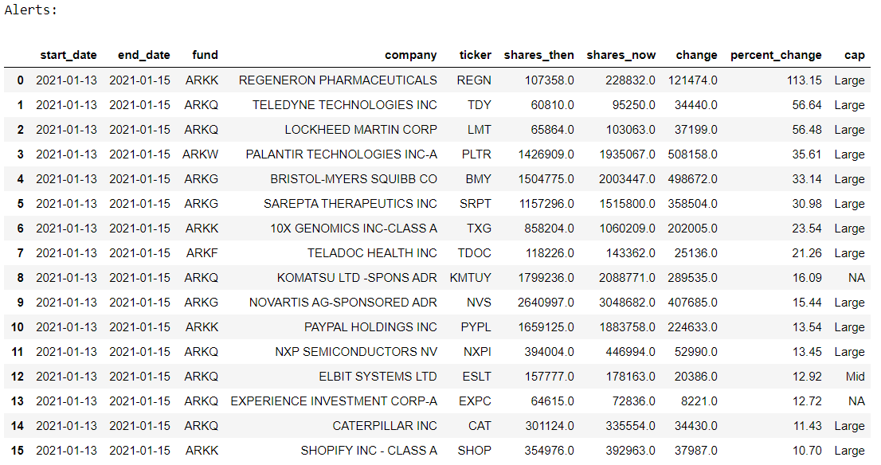
Change Logs – 1/18
change_in_portfolio()
Alert functionality
Added new output “alerts”
Copied “changes” and searched for >abs(10%) change in position sizing

Slide 8
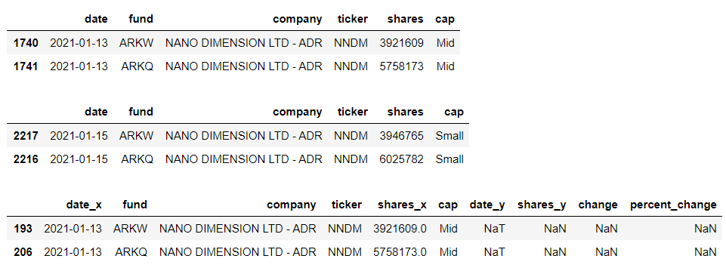
Change Logs – 1/18
change_in_portfolio()
Issue:
Cap size changing
Already knew this would become an issue eventually
Merged DF errors because “cap” changes between these dates and resulted in “shares_y” = NaN
Solutions:
a) Could update cap size for all entries daily
b) Modify `sectors.db` to include [‘cap’,’market_cap’] and update that every so often (avoids the updating of cap/market_cap within the arkfund.db --- however requires calls to `sectors.db` separately to append data together in functions that require that info.
Leaning toward solution (b)
1/13 “Mid”
1/15 “Small”
a.merge(b) --

Slide 9
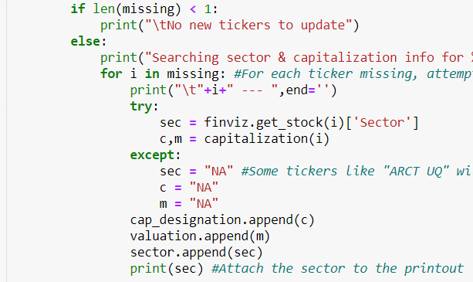
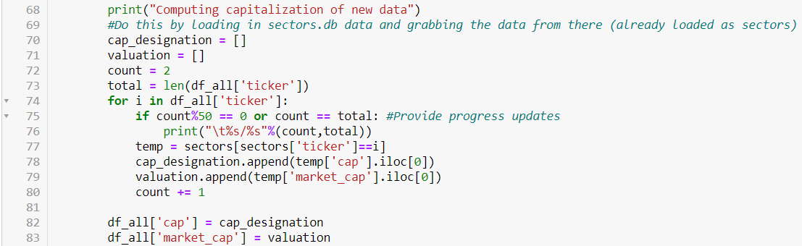
Change Logs – 1/18
update_sectors() / update_arkfund()
Per previous slide … moved capitalization() function that was sitting inside update_arkfund() into update_sectors()
Per that action
1) sectors.db now contains [‘cap’,’market_cap’]
2) ARKFunds.db still contains [‘cap’,’market_cap’] --- however no does not compute updated capitalization values … it merely references (1) and steals it from sectors.db upon loading new data
Could alternatively remove this info from the table, but when the database grows I worry making calls to 1 year of data may slow the processing if it has to load ARKFund.db AND sectors.db THEN merge to create ‘cap’,’market_cap’ for ARKFund.db’s dataframe in memory for EACH function that makes this call
3) update_capitalization() function’s purpose was to update cap & market_cap data for `ARKFund.db` but now needs to be repurposed for to update BOTH `ARKFund.db` and `sectors.db` appropriately
update_sectors() changes: Added c,m & subsequent vars
update_arkfund() changes: Modified capitalization code to grab from sectors (already loaded var)

Slide 10

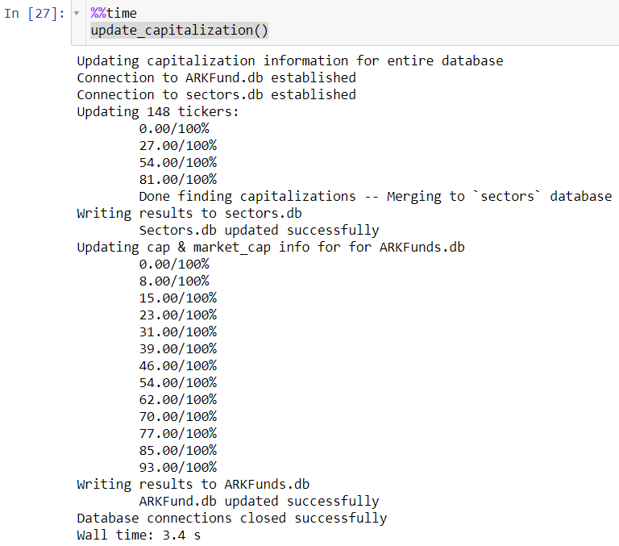
Change Logs – 1/18
update_sectors() / update_arkfund()
Per previous slide … moved capitalization() function that was sitting inside update_arkfund() into update_sectors()
Per that action
1) sectors.db now contains [‘cap’,’market_cap’]
2) ARKFunds.db still contains [‘cap’,’market_cap’] --- however no does not compute updated capitalization values … it merely references (1) and steals it from sectors.db upon loading new data
Could alternatively remove this info from the table, but when the database grows I worry making calls to 1 year of data may slow the processing if it has to load ARKFund.db AND sectors.db THEN merge to create ‘cap’,’market_cap’ for ARKFund.db’s dataframe in memory for EACH function that makes this call
3) update_capitalization() function’s purpose was to update cap & market_cap data for `ARKFund.db` but now needs to be repurposed for to update BOTH `ARKFund.db` and `sectors.db` appropriately
4) Also updated capitalization() to say “Nano” instead of “NA” for companies that don’t fit Micro,Small,Mid,Large
update_capitalization() changes:
Added functionality to update sectors.db
THEN use that info to update ARKFund.db
… it runs so fast! (only ~4s for 1/4 - 1/15 data)

Slide 11
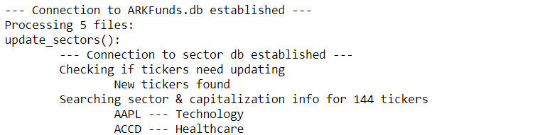
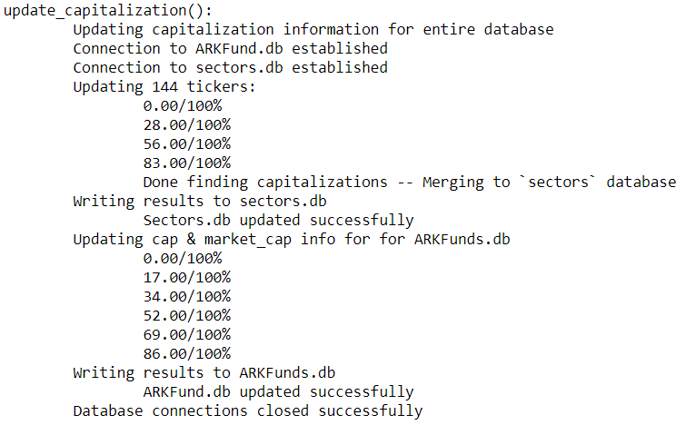
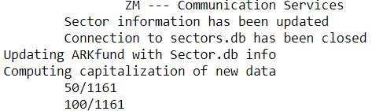
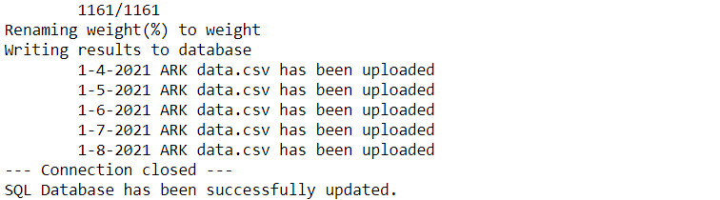

Change Logs – 1/18
Changed printout
Update_arkfund() is the main function and it has a lot of printouts … it’d be great to know which subroutine is currently running → Change prinouts of various things to make it clearer
In general … just adding print({name_of_function():}) and tabbing everything an additional tab over
Update_sectors()
Backup_data()
Update_capitalizations()
Here is the printout of 1/4 to 1/8 data loading:
Running all (except backup_data) and
processing 1/4 – 1/8 data only took 6s! (33s if sectors.db actually has to be updated)

Slide 12
Change Logs – 1/18
Recap
Update_arkfund() was always the main function … but didn’t fully fulfill that purpose
Update_capitalization() has been pushed into update_arkfund()
Change_in_portfolio() has been pushed into update_arkfund()
Change_in_portfolio() also now reports an “alerts” df of significant change in share size
Sectors.db has been updated to contain [‘cap’,’market_cap’] information
Subsequently ARKFund.db still contains that info, but now obtains its capitalization information from sectors.db instead (resulting in faster processing & less calls to the finviz API)
This change resolves issues that I foresaw could arise in computation (where cap size differs from 1 trading session to the next). With the data coming from sectors.db the information will be unified across trading sessions --- and update_capitalizations() will run on a weekly Friday basis to keep it up-to-date
Update_arkfund()
Now takes action to delete duplicate files --- this handles situations like MLK holiday where the script will download even though no new data would have been generated by ARK investments

